Slide 1
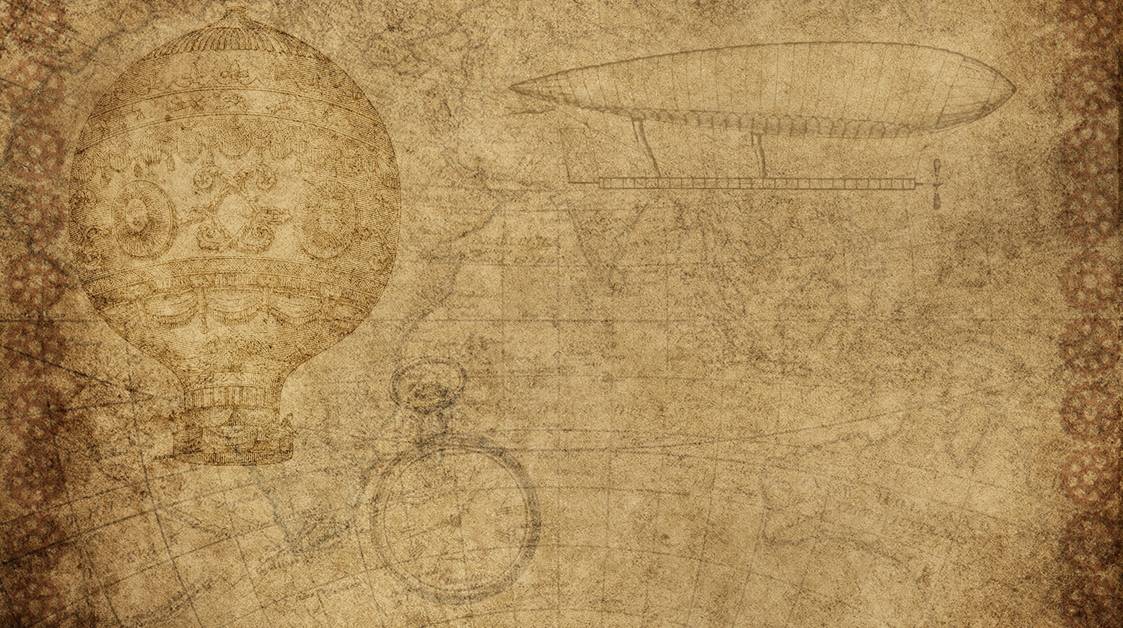

Physics Destroyer
Matthew Peace
Dustin Bramos
Steve Catherman
Steven Jazrawi
Chris Wiegand

Slide 2

Application Goal
Our goal is to create a physics calculator that will allow users to enter known variables and automatically solve all equations possible with those known variables.
Physics students would be able to use this application to quickly figure out variable types.

Slide 3

Product Backlog
Add recursion for further problem solving
“ I’d like the calculator to take in the known inputs and be able to use those to solve for the other variables until all variables are known.”
Add unit conversion
“ I only know how many miles traveled, but would like it converted to meters instead.”
Implement full GUI with multiple formulas/variables and unit dropdown
"As a physics student, I would want to be able to have a longer range of variables to type in and choose what formula/unit to use.“

Slide 4
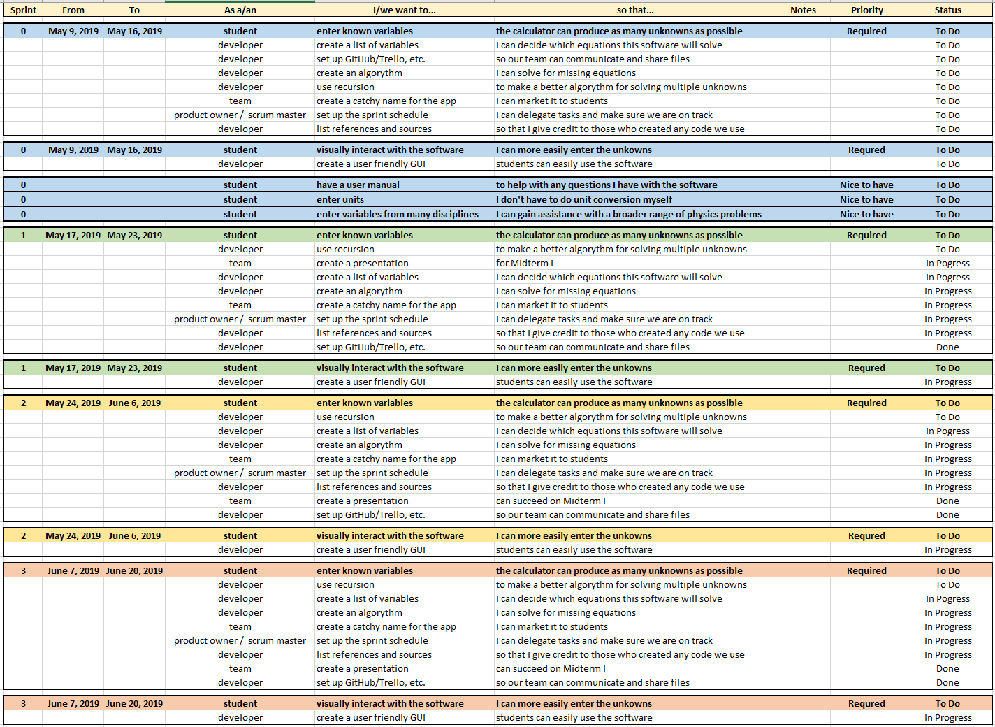

Slide 5

Schedule
Finish Simple 3 variable calculator with basic GUI
At least have a simple formula that can be solved for an variable if given at least 2 out of the 3 variables.
5/23/2019
More complex algorithm, integrate into GUI
Have the calculator working enough to be able to solve for a lot more variables.
6/6/2019
Implement full calculator with GUI, recursion, and units
Have the final calculator work with a GUI that can take in multiple inputs, and change variables.
6/20/2019

Slide 6
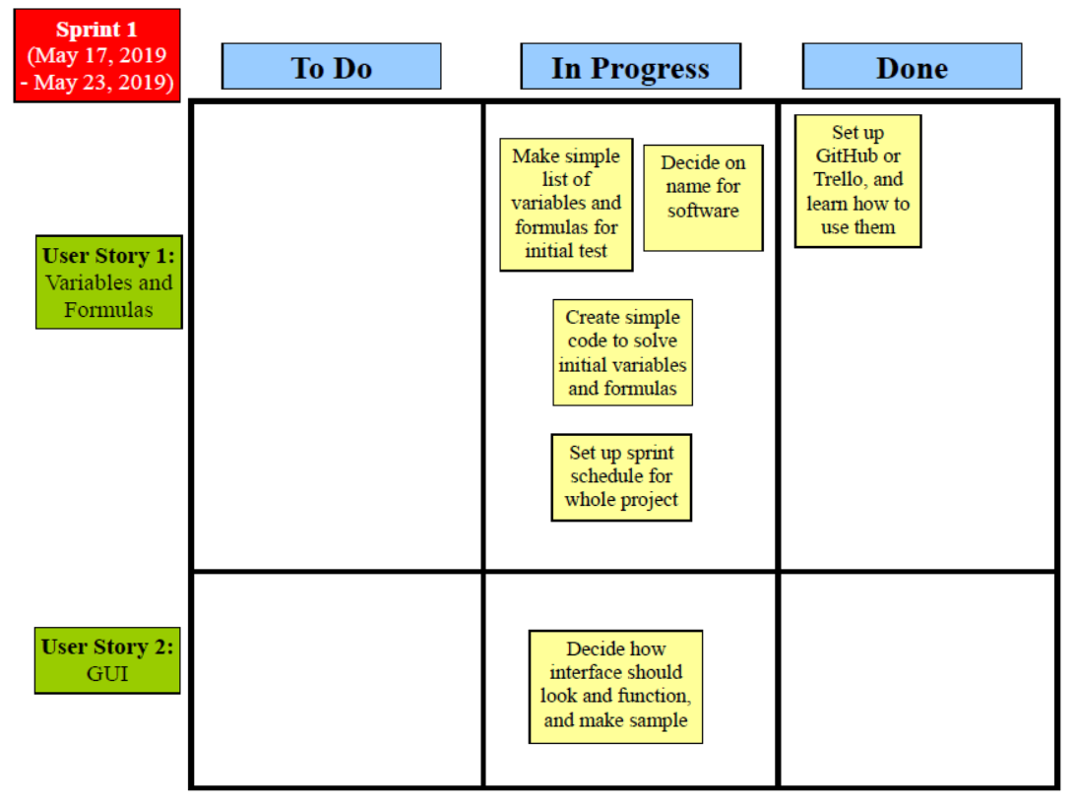

Slide 7
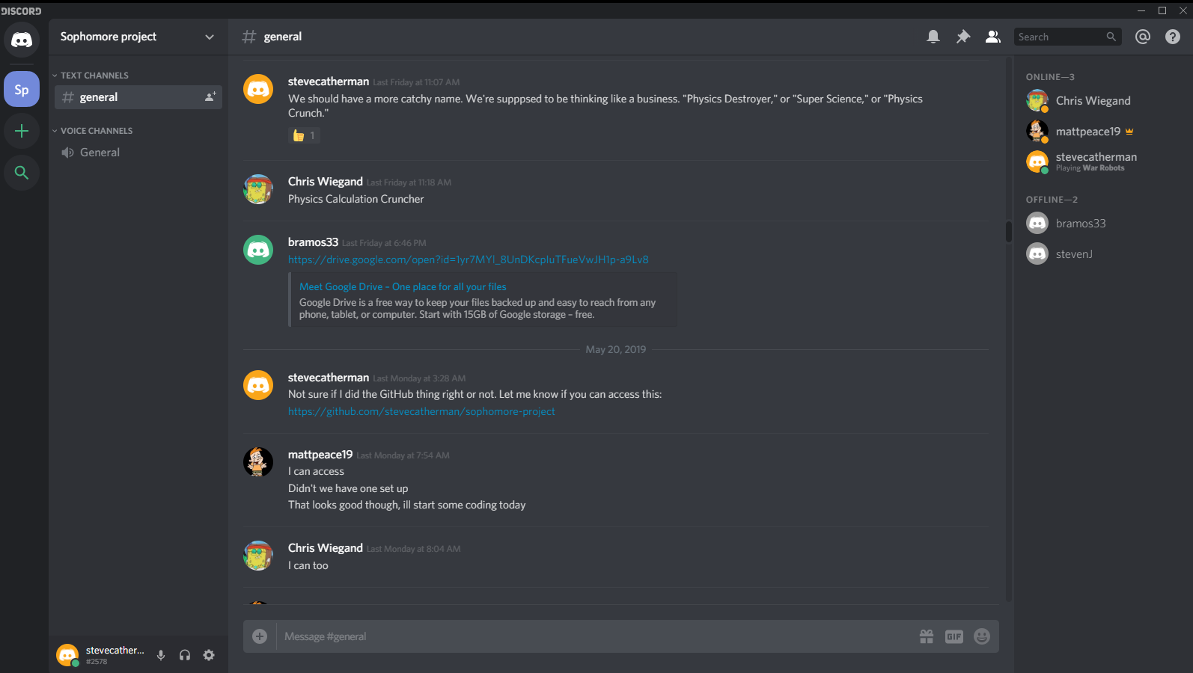

Slide 8
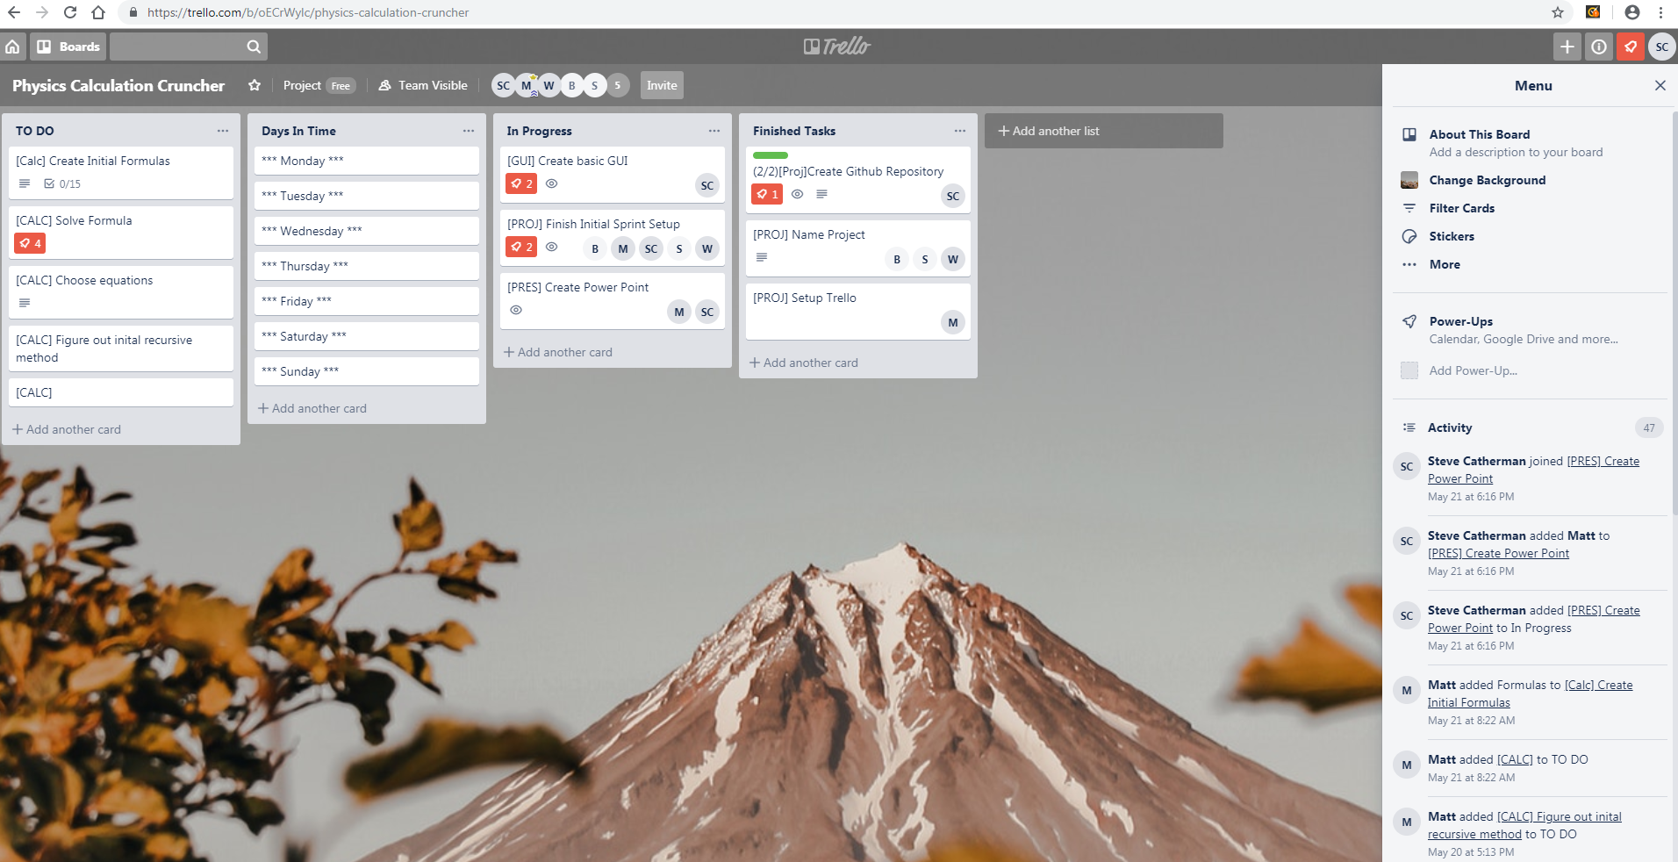

Slide 9
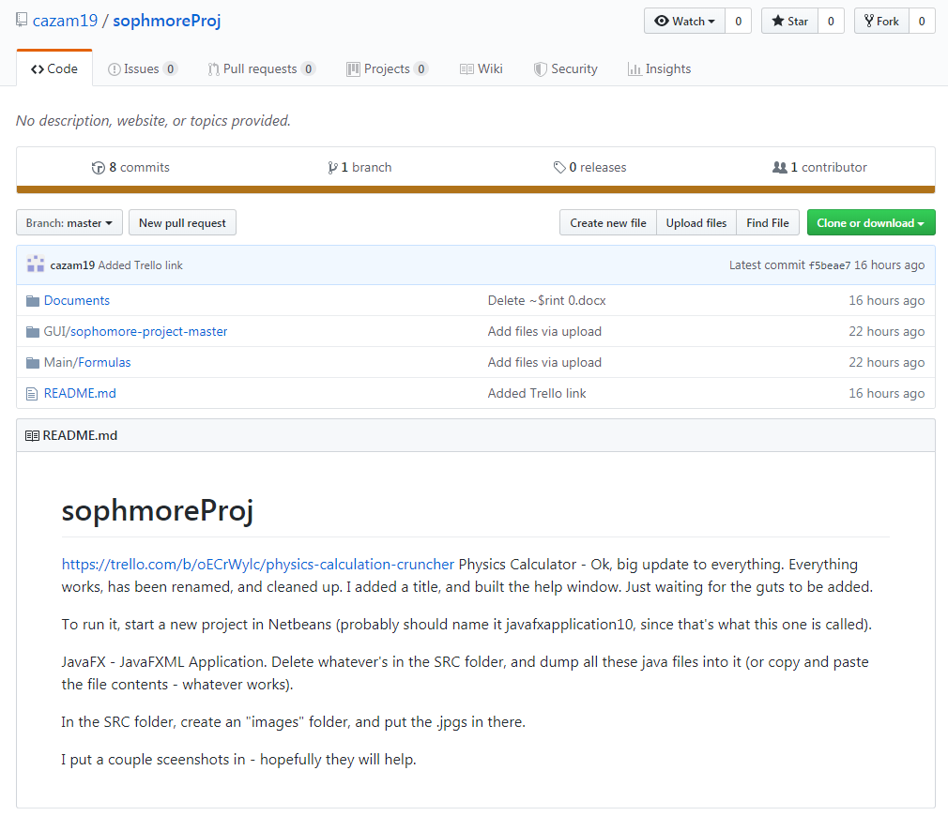

Slide 10
Challenges
How we wanted to divide the sprints up
We decided to have:
Sprint 1: Variables, equations, simple code
Sprint 2: More complex algorithm, integrate into GUI
Sprint 3: Implementing recursion, adding units, and more variables
How we were going to collaborate
We are now using GitHub, Trello, Discord, and Google Docs.
What formulas we wanted to use, and how detailed they were going to be
Initial formula will be a=∆v/t, but for sprint 2 we made a list of ones that are going to be used. https://trello.com/b/oECrWylc/physics-calculation-cruncher

Slide 11
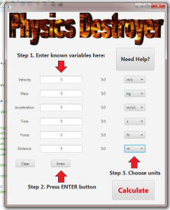
Example
This is how we envision the finished calculator

